Slide 1
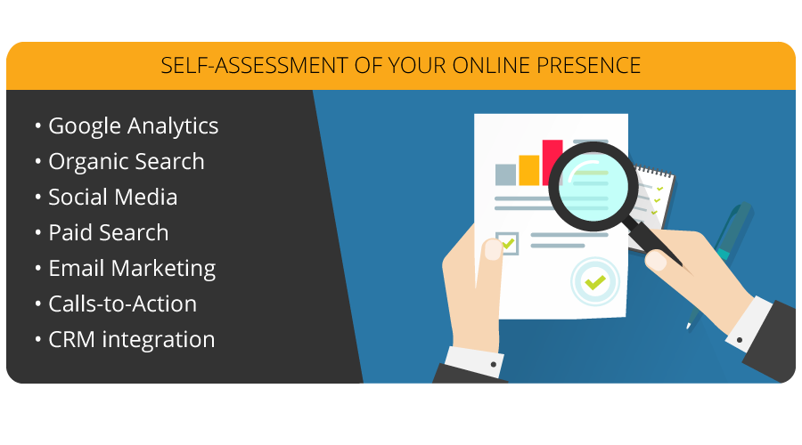
Digital Marketing Self-Assessment for Language Schools
Elias Faethe
Higher Education Marketing
elias@higher-education-marketing.com

Slide 2
Today’s Presentation
Identifying target audiences
Using Google Analytics to track and measure results
Researching and identifying relevant SEO keywords
Leveraging multi-language content
Social media suggestions and analytics
Using Pay-per-Click (PPC) to generate quality leads
Are you ready for the mobile generation
Generating inquiries and following up

Slide 3
Why Digital Marketing for Schools?
Today’s typical prospective students are digitally literate, informed and engaged
They expect consistent messaging & outreach tailored to their interests, goals, & concerns
Students want an open window into your school’s mission and rather than overt self-promotion/selling
Meaningful dialogue and relationship-building with your school community, from their first encounter, to enrollment, and beyond

Slide 4
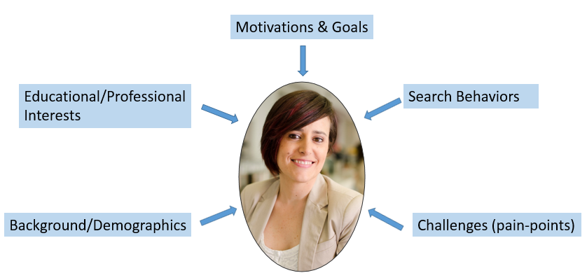
Persona Development: Identify your Target Audience(s)
Segment prospects by: program, level, source country, etc. & research their distinct characteristics:

Slide 5
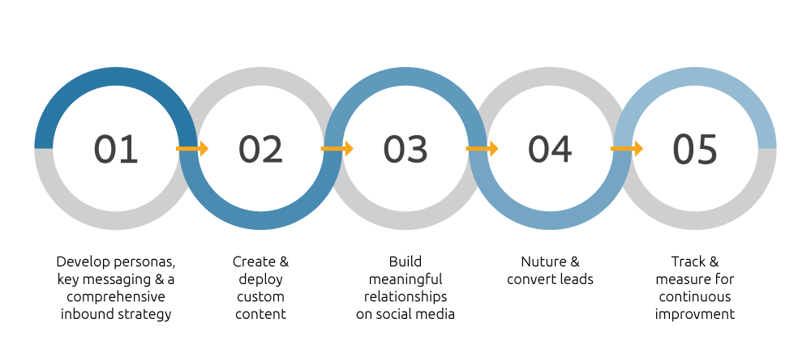
The Inbound Marketing Process

Slide 6
Persona Development: Research Tools
Survey your admissions & recruitment team for their insights
Survey/poll your students & alumni directly
Use journey-mapping/heat-mapping to track key touchpoints
Conduct market research to better understand what is impacting decision-making

Slide 7
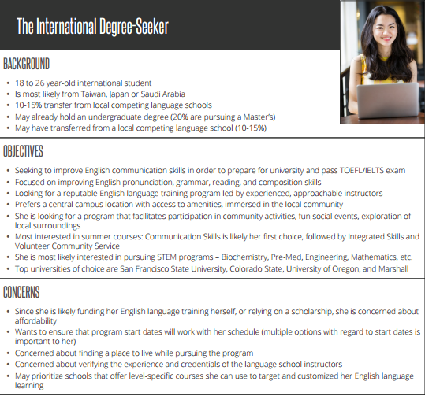
Persona Development: Consolidate Data into Profiles

Slide 9
The Channel Report
The Channels report under Acquisition, gives you macro level insights into the various channels you are using to attract traffic to your website.

Slide 10
What are the main Channels?
Organic Search: SEO Traffic from search engines
Email: links in email campaigns
Direct: users enter the URL directly in the browser
Referral: traffic from other sites yours is linked on
Social: Facebook, Twitter, LinkedIn, etc.
Paid Search: Google AdWords, Bing ads, etc.
The Channel Report is crucial to helping you ascertain which of your marketing initiatives are having the most success.

Slide 11
Common website goals for educational institutions
Online application form
Ask a question form
Contact us form
PPC inquiry form
Online payment gateway
Live chat event
PDF Brochure download event

Slide 12
Use lead capture forms to capitalize on your website traffic

Slide 13
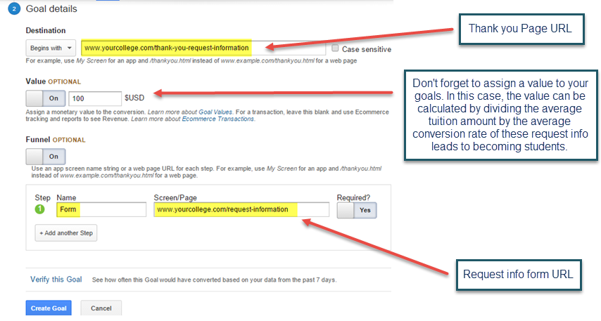
Setting up Website Goals

Slide 14
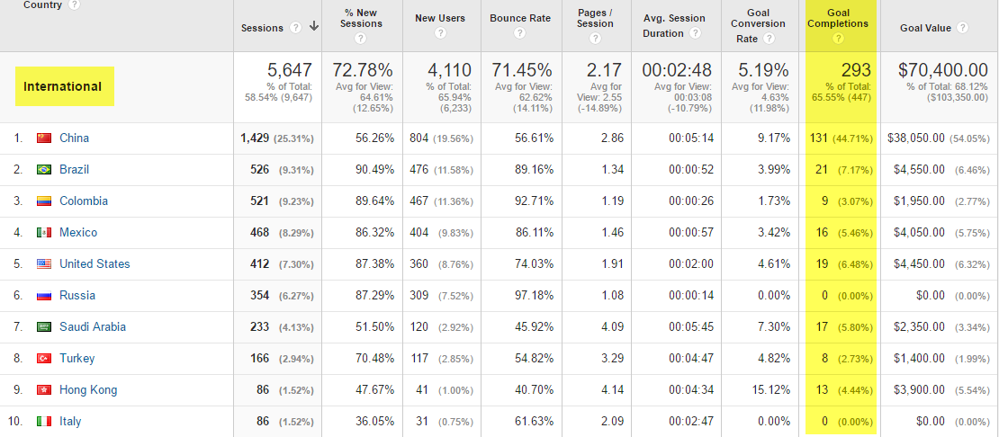
Benchmark your current marketing activity and results

Slide 15
Month over Month Website Goals

Slide 17
What is SEO & its role in Digital Marketing?
The process of optimizing website content, design, & performance to generate visitor traffic from “organic” (versus paid) search engine results
SEO is vital for ensuring your content and website get found online by prospective students

Slide 18
Start with SEO
Measure your Organic Search Traffic
Identify new international keywords
Use the correct information architecture
Use international targeting in Webmaster tools
Translate and optimize

Slide 19
Measuring your SEO Efforts Year over Year
Year over year comparison is very useful to measure the health of your SEO Traffic and conversions from that channel

Slide 20
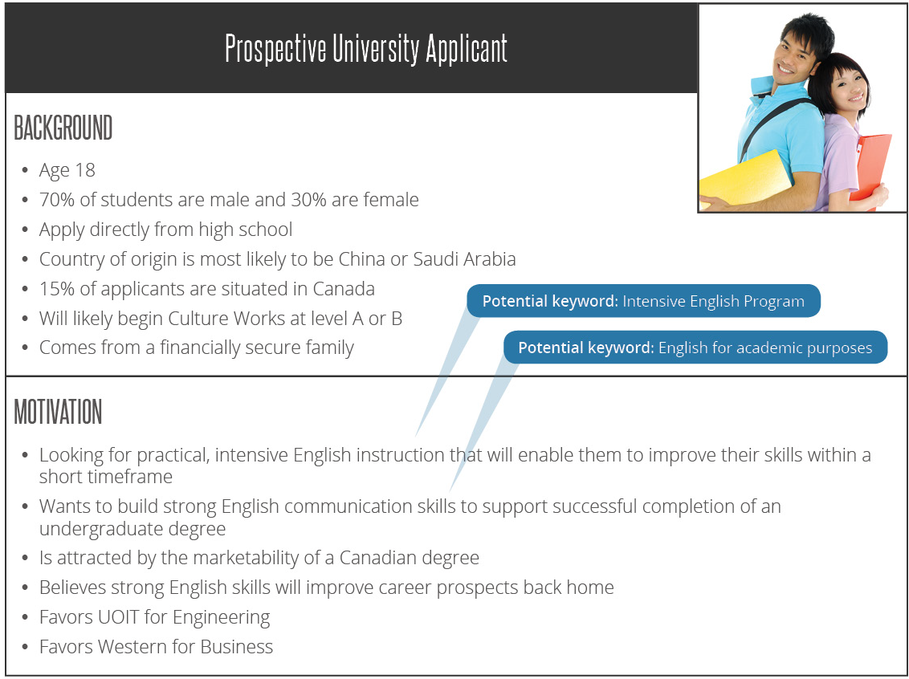
Look for Keywords Your Primary Personas Might Search For

Slide 21
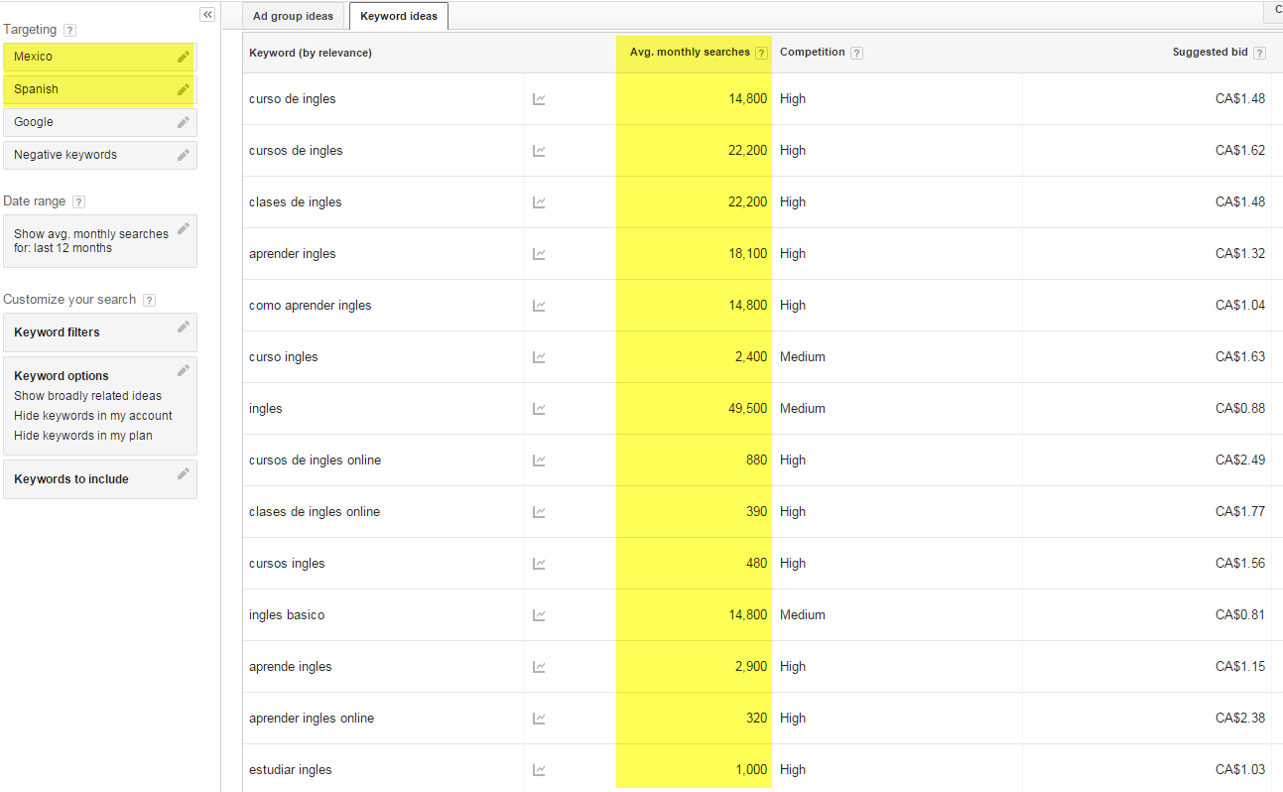
Keyword Research

Slide 22
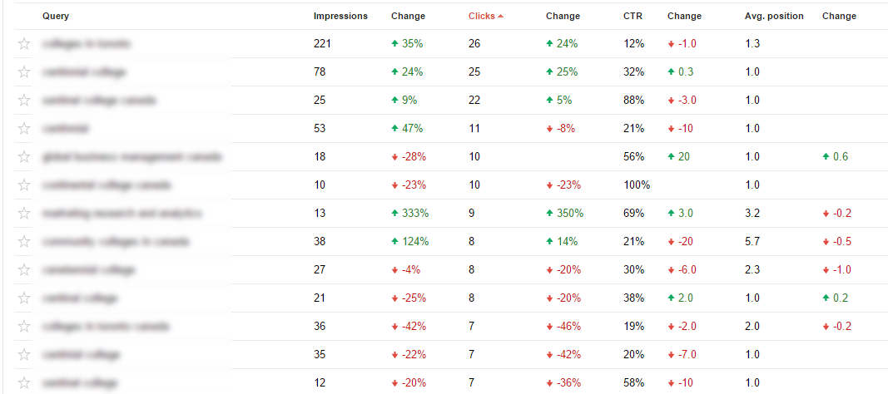
Evaluate your Organic Search Queries

Slide 23
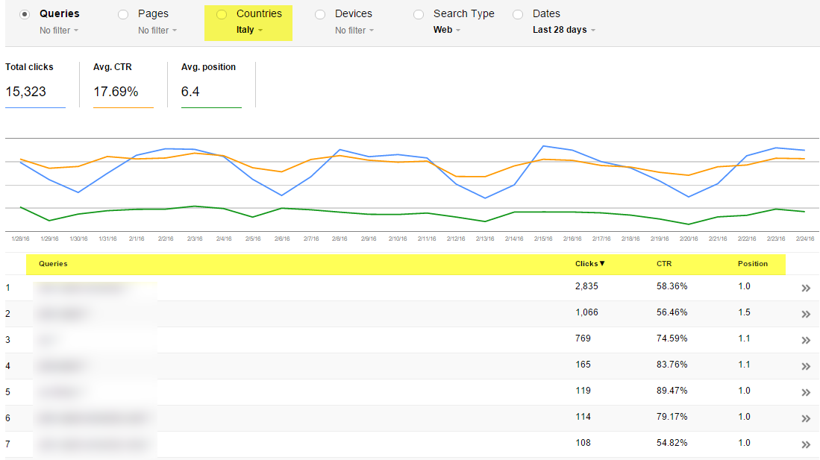
Understand your keyword rankings by country

Slide 24
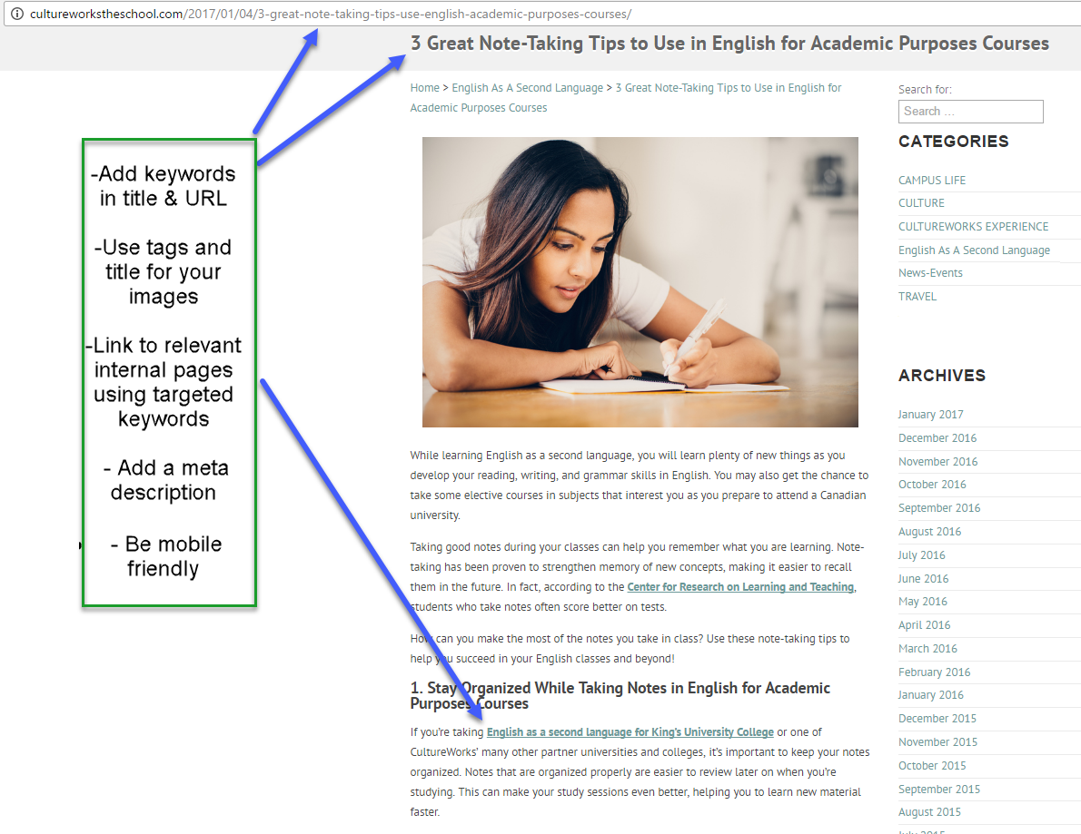
On Page SEO Example

Slide 25
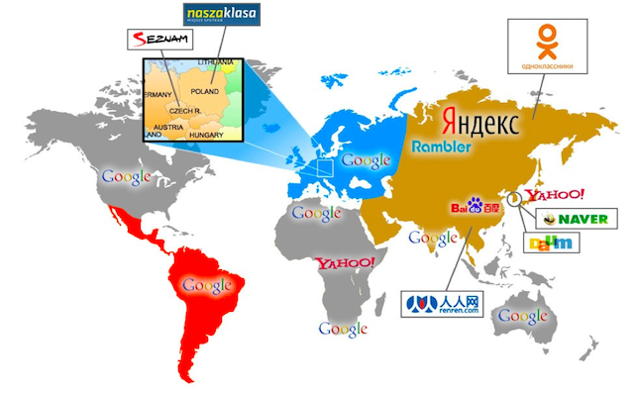
Plan for search globally, target locally
For country specific data:
http://ptgmedia.pearsoncmg.com/images/9780789747884/supplements/9780789747884_appC.pdf

Slide 27
Develop Multi-language Content

Slide 28
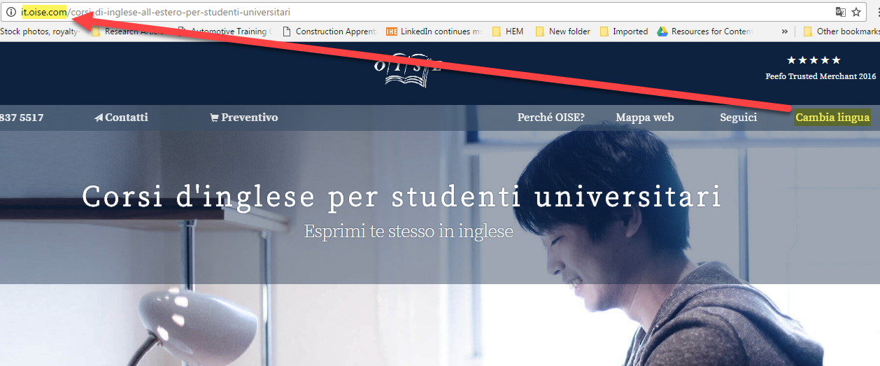
Use the correct architecture when developing multi-language content
This website uses the subdomain approach to separate the multi-language content

Slide 29
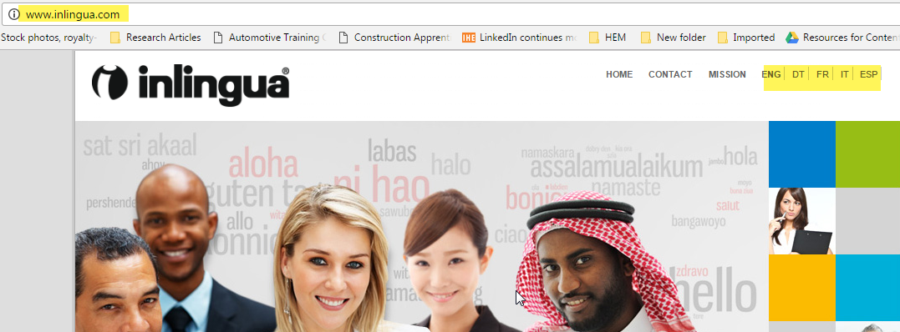
Use the correct architecture when developing multi-language content
This website uses the top level domain - TLD approach to separate the multi-language content

Slide 30
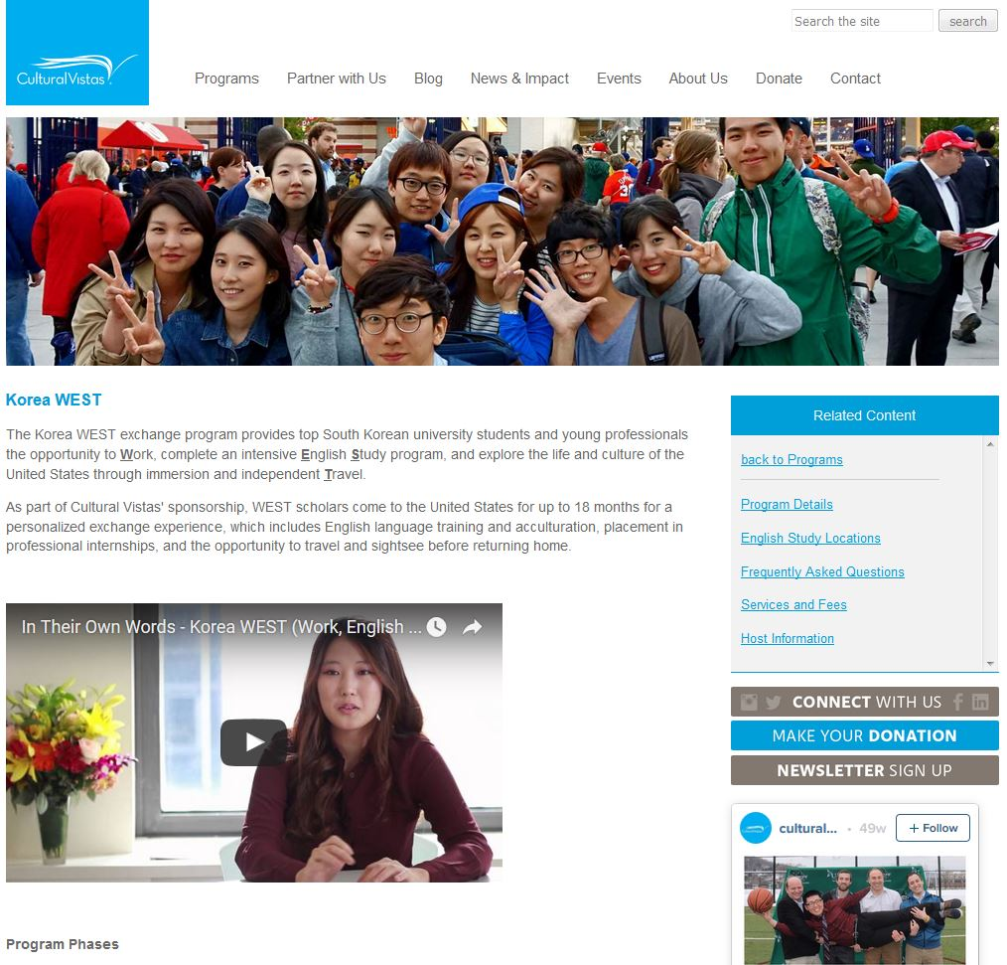
Develop Content for Target Countries

Slide 31
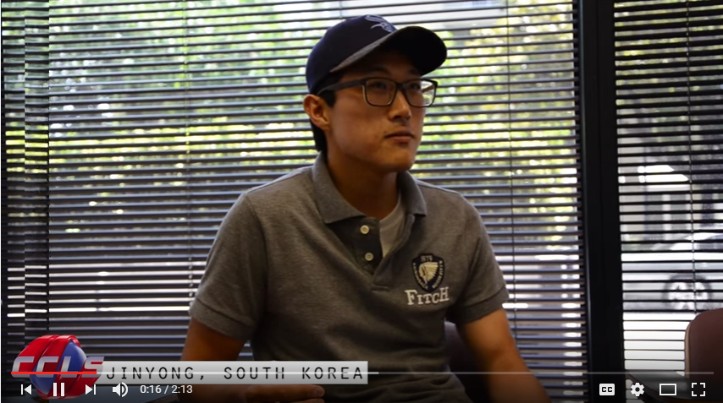
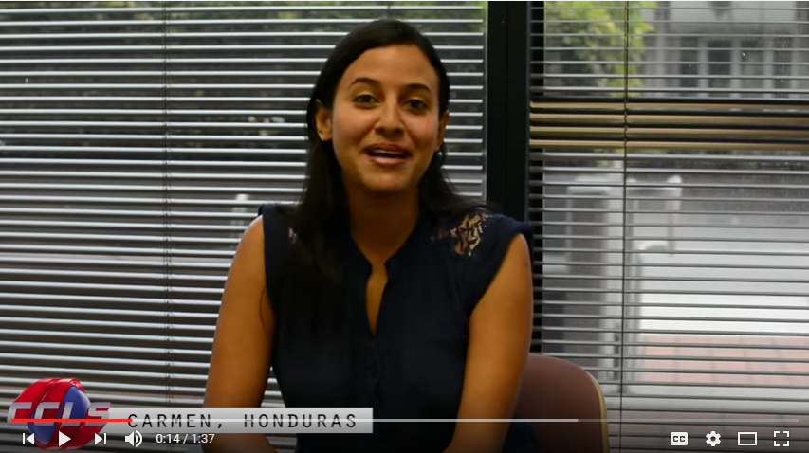
Use Video Testimonials to Engage Prospects

Slide 33
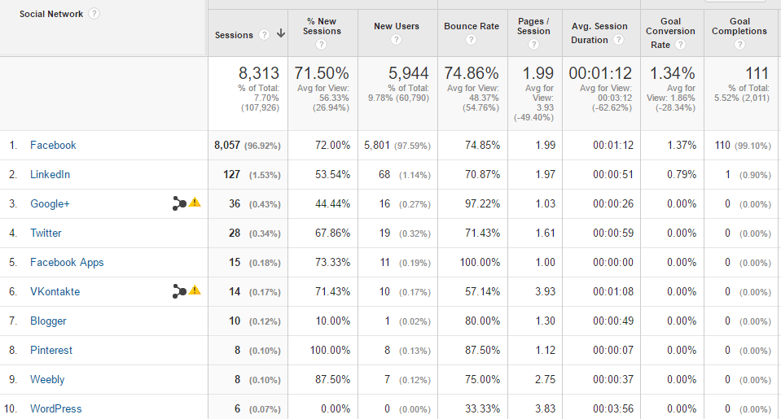
Social activity directed to your website

Slide 34
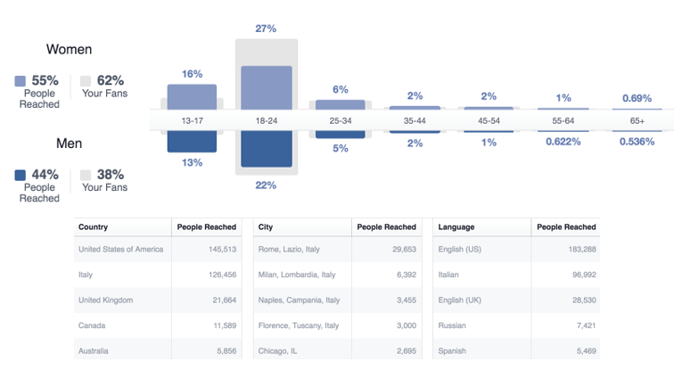
Facebook demographic and location stats

Slide 35
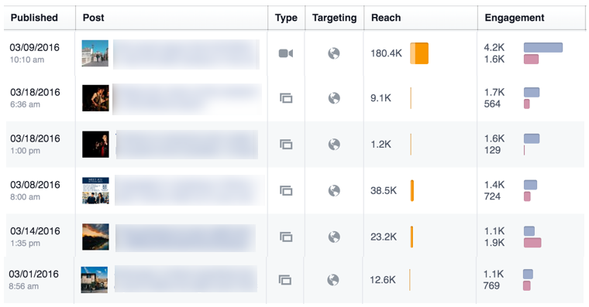
Facebook post reach and engagement

Slide 36
Contest and quizzes

Slide 37
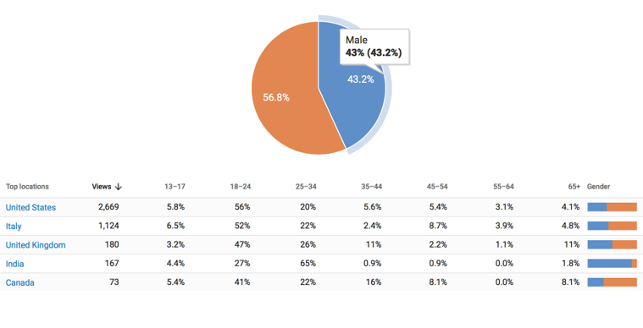
YouTube demographic insights

Slide 39
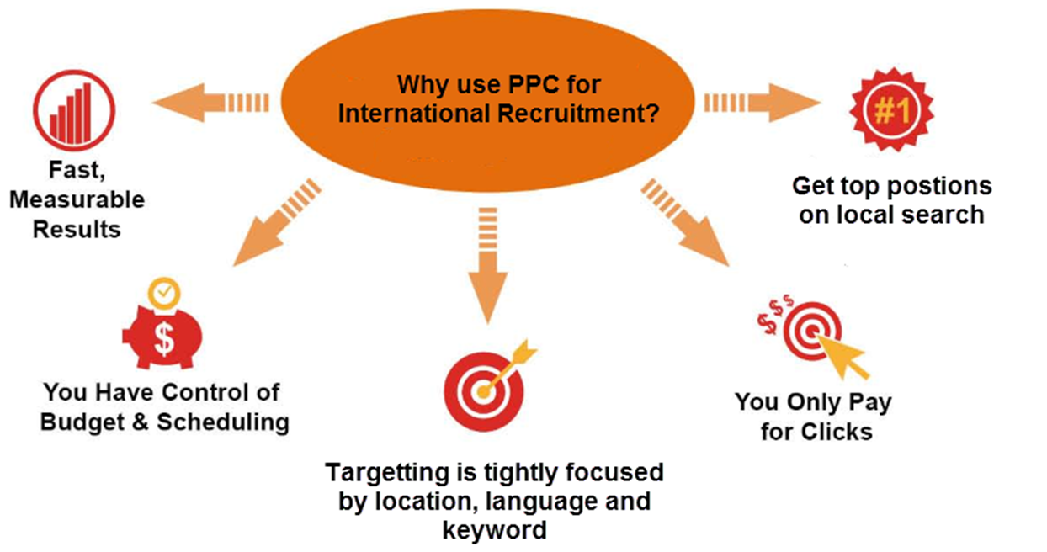
Why paid Search?

Slide 40
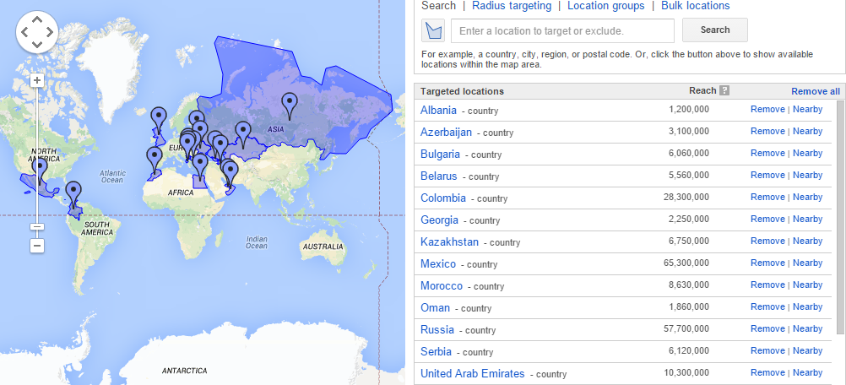
Set your Country Targeting in Google AdWords

Slide 41
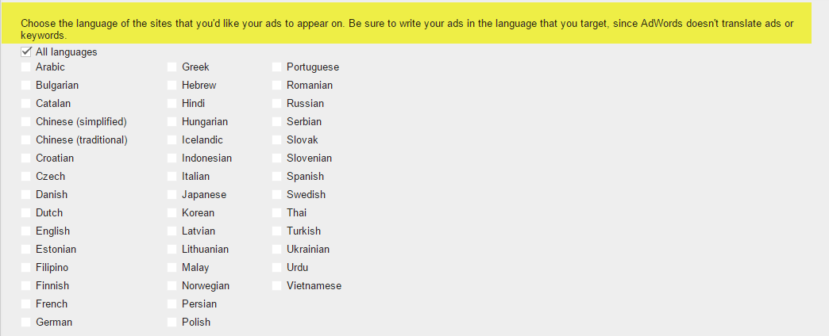
Set your Languages in Google AdWords

Slide 42
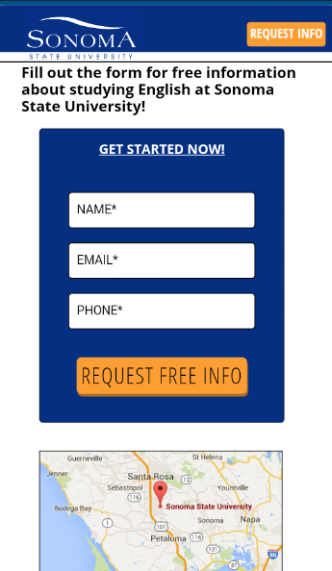
Use responsive landing pages for your campaigns

Slide 43
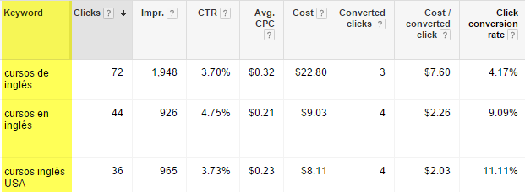
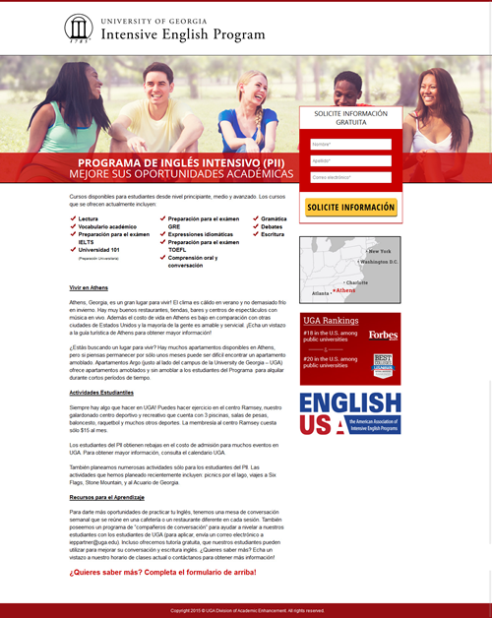
Consider localizing your Google AdWords campaigns

Slide 44
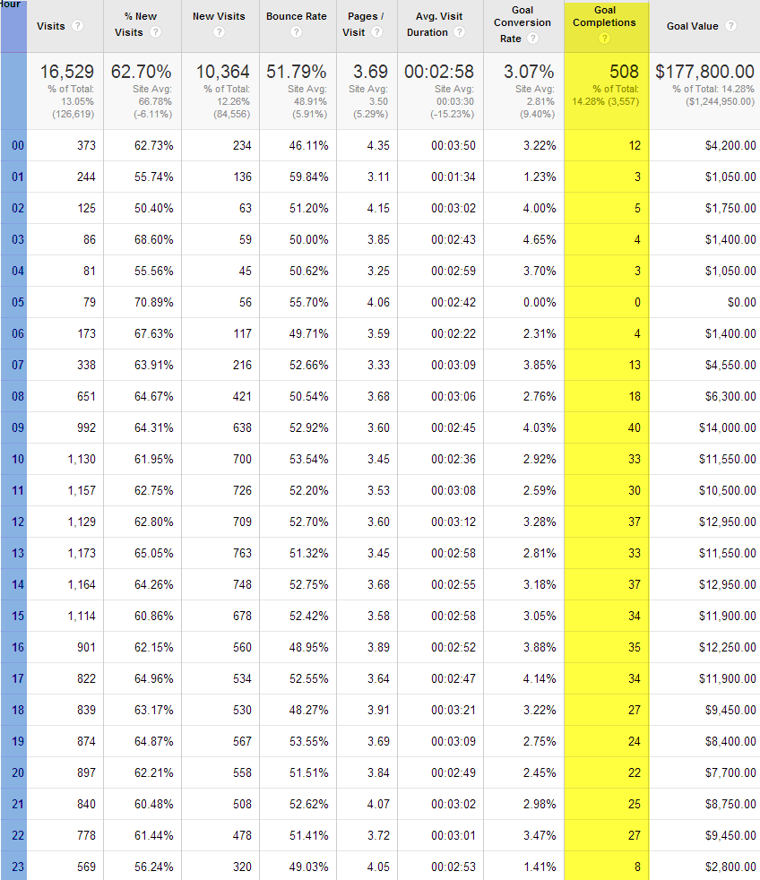
Use Adwords Day Parts
Be smart about setting your account’s time zone.
Target your ads when they are the most effective.

Slide 45
Google AdWords mobile conversions
Be sure to segment your AdWords activity by device or you may have some surprises!
Adjust the mobile and tablets bids based on performance and goals

Slide 46
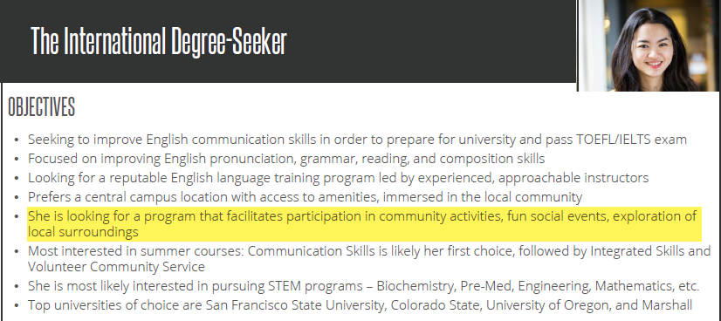
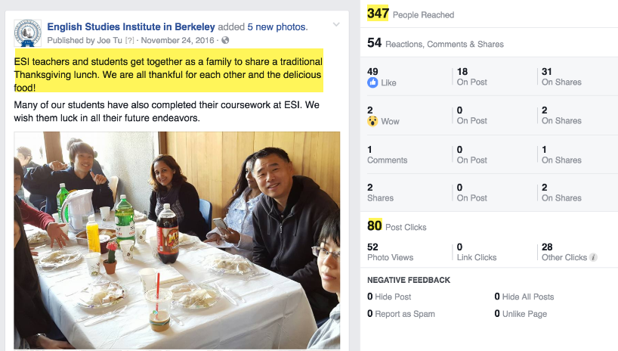
Use Personas to Focus You Social Initiatives

Slide 47
Is your site mobile friendly?

Slide 48
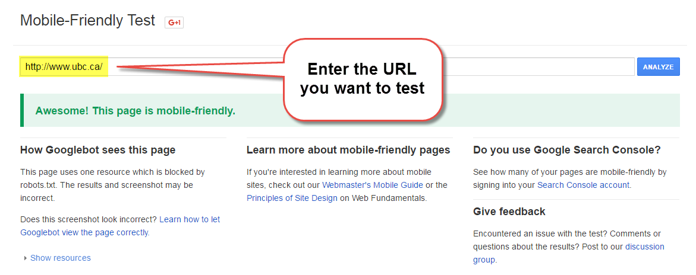
Find out here:
https://search.google.com/search-console/mobile-friendly

Slide 49
Why mobile?
31% mobile traffic
25% of website goals

Slide 50
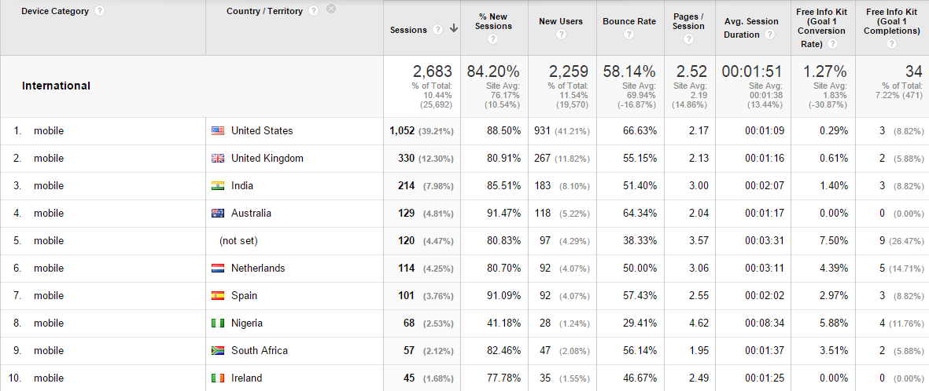
What’s your Mobile traffic like by country

Slide 52
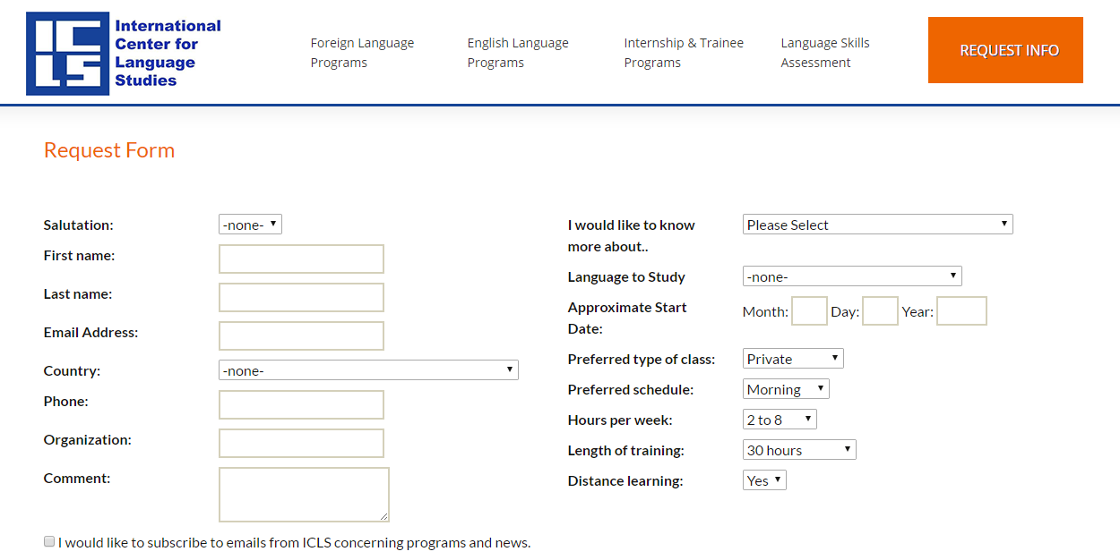
Make use of calls to actions on your website

Slide 53
Make multi-language advisors available

Slide 54
Use Online Chat to Talk with Prospects

Slide 55
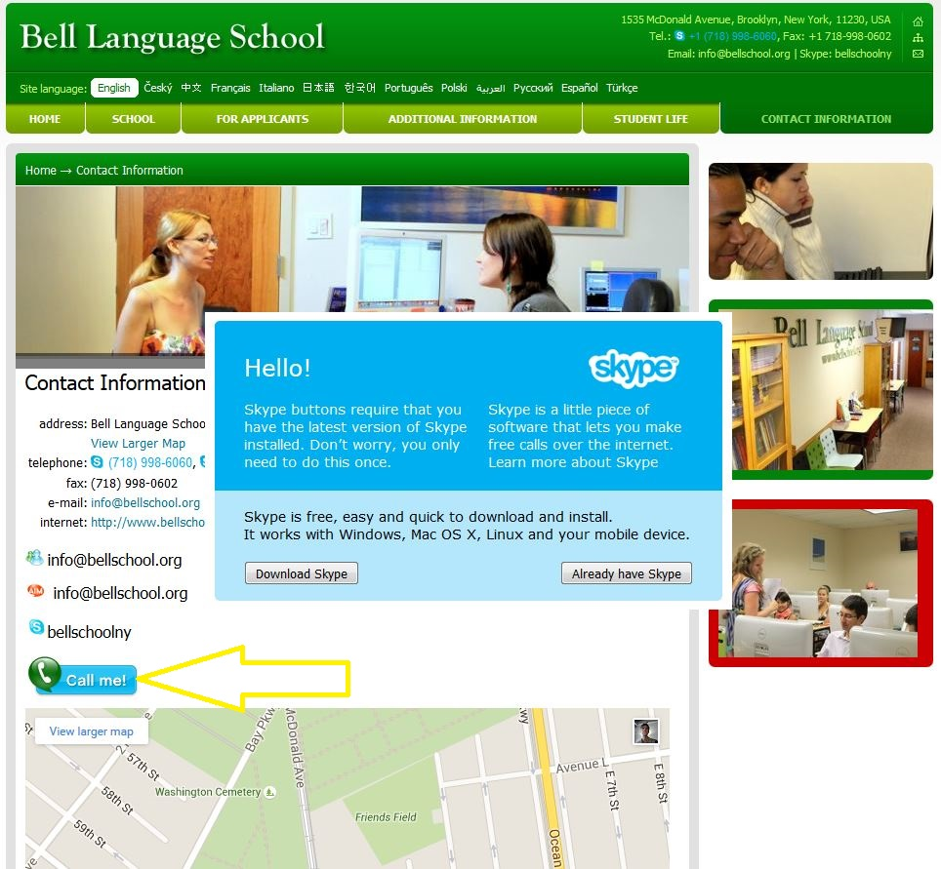
Offer Skype Sessions

Slide 56
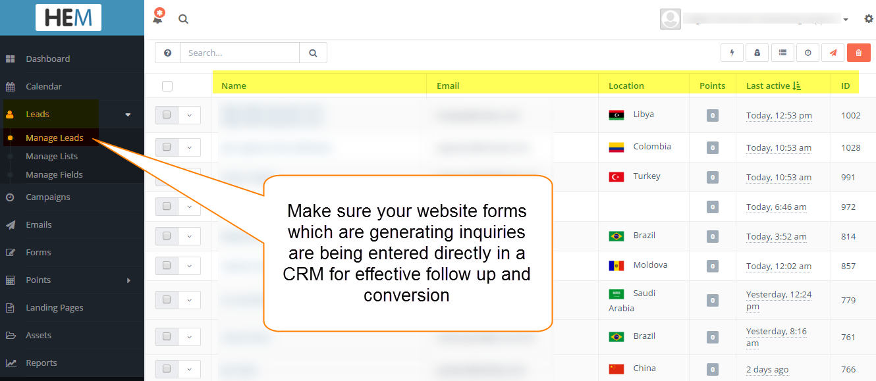
Do you have a CRM system to manage your potential student inquiries?

Slide 57
Priorities and recommendations for your International digital marketing
Identify Benchmarks, set new Goals
Invest in SEO
Develop content aimed at international students
Use international PPC lead gen campaigns
Get mobile NOW!
Follow up with your leads!

Slide 58
Ressources to look up
Google
Google Campaign Builder - https://ga-dev-tools.appspot.com/campaign-url-builder/
Google Keyword Research - https://adwords.google.com/ko/KeywordPlanner/
Google Webmaster Tools -https://www.google.com/webmasters/
Free Readings (all below http://www.higher-education-marketing.com/resources/)
2017 eBook on Digital Marketing
Inbound Marketing Checklist
Google Analytics Checklist
PPC Checklist

Slide 59
Contact
Elias Faethe European Clients Representative
Higher Education Marketing
Office: +49 421 84780289
Mobile: +49 177 3322218
or directly schedule a meeting

